Slide 1





BASICS OF INVESTING
BASICS OF INVESTING
Growing your money for the future.

Slide 2


TALK
LAWYER
  Investments have risks and you should know what they are before investing your hard-earned money – you could lose all of it!​
  We’re not going to talk about cryptocurrencies or cannabis – see previous bullet point.​
  What we talk about today is for educational purposes only – it’s not specific advice.​
  I’m not your accountant and this is not tax advice – we’re talking about general concepts.​
  I’m also not your lawyer.​
  You should always work with qualified professionals for your own individual circumstances.​
  What I say may not make you wealthier, but it will make you wiser.

Slide 3


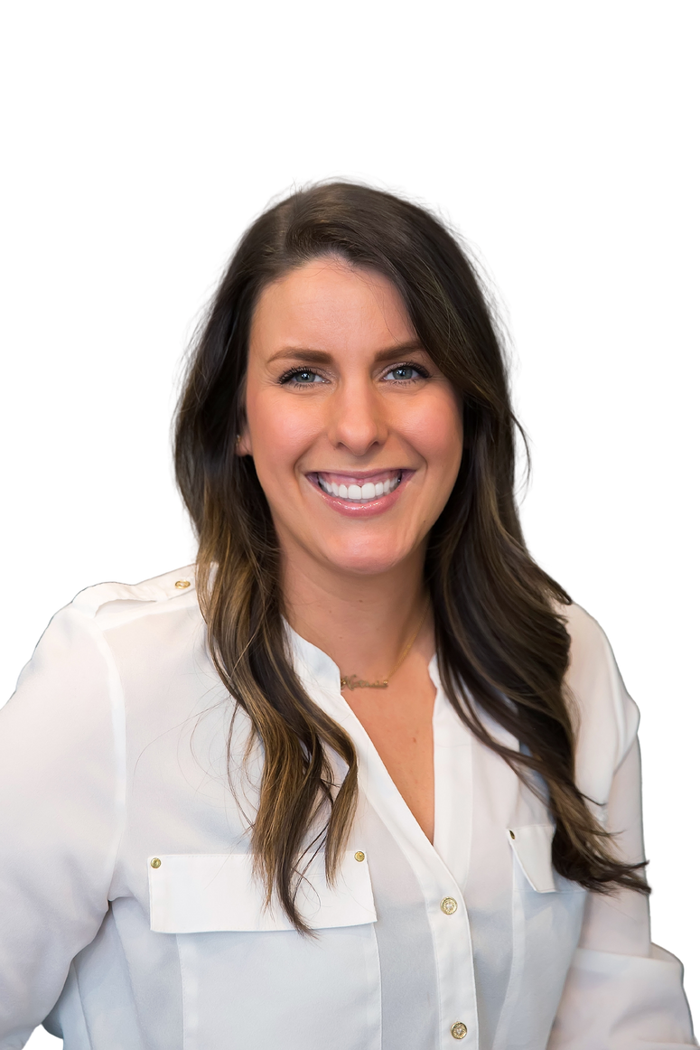
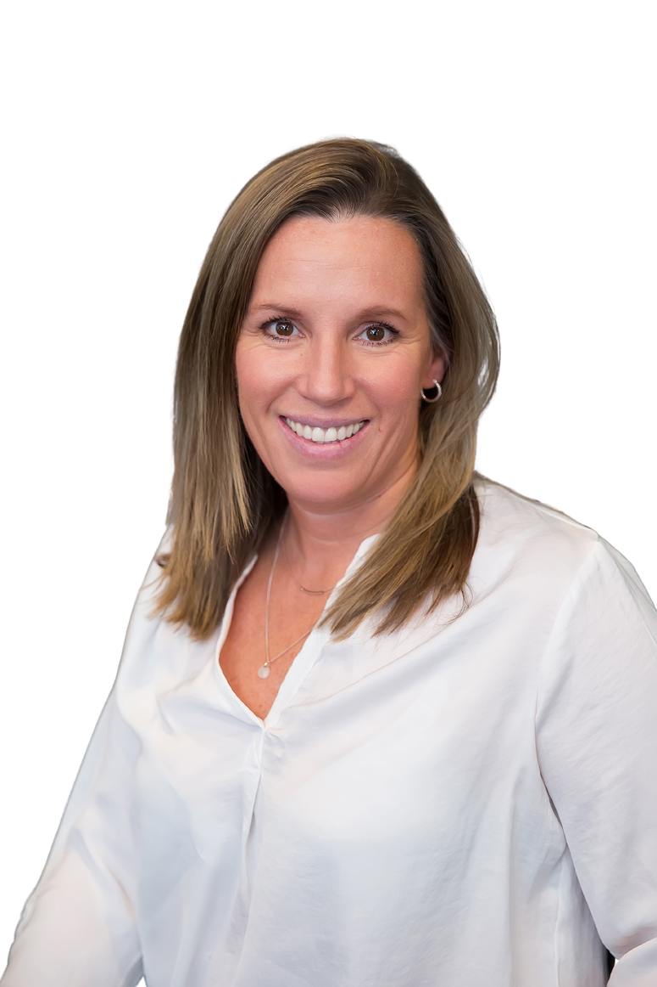

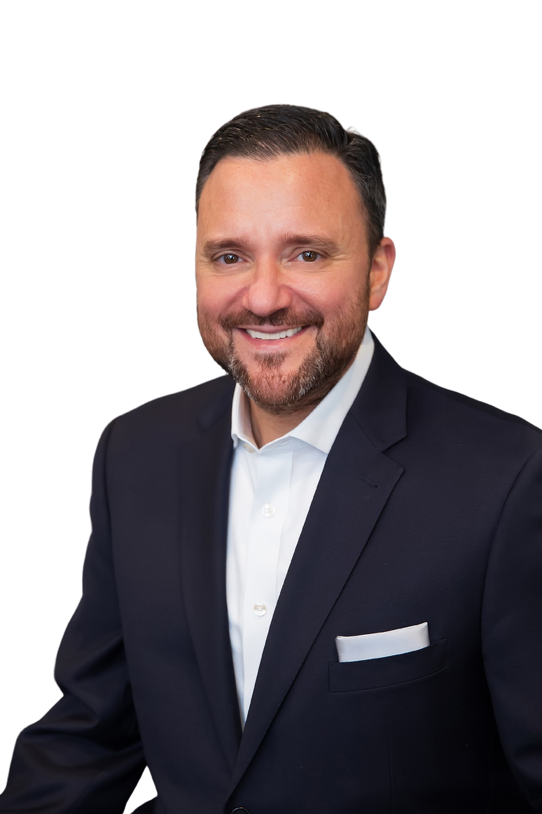


US
ABOUT
OUR SUPPORT
John Caserta, MSFS,
ChFC®, RICP®, CLU®
Managing Director
Nathalie Edeen
Advisor & Planning Specialist
Amy Crookshank
Advisor & Planning Specialist
Gimli
Office Support
Theo
Office Support

Slide 4

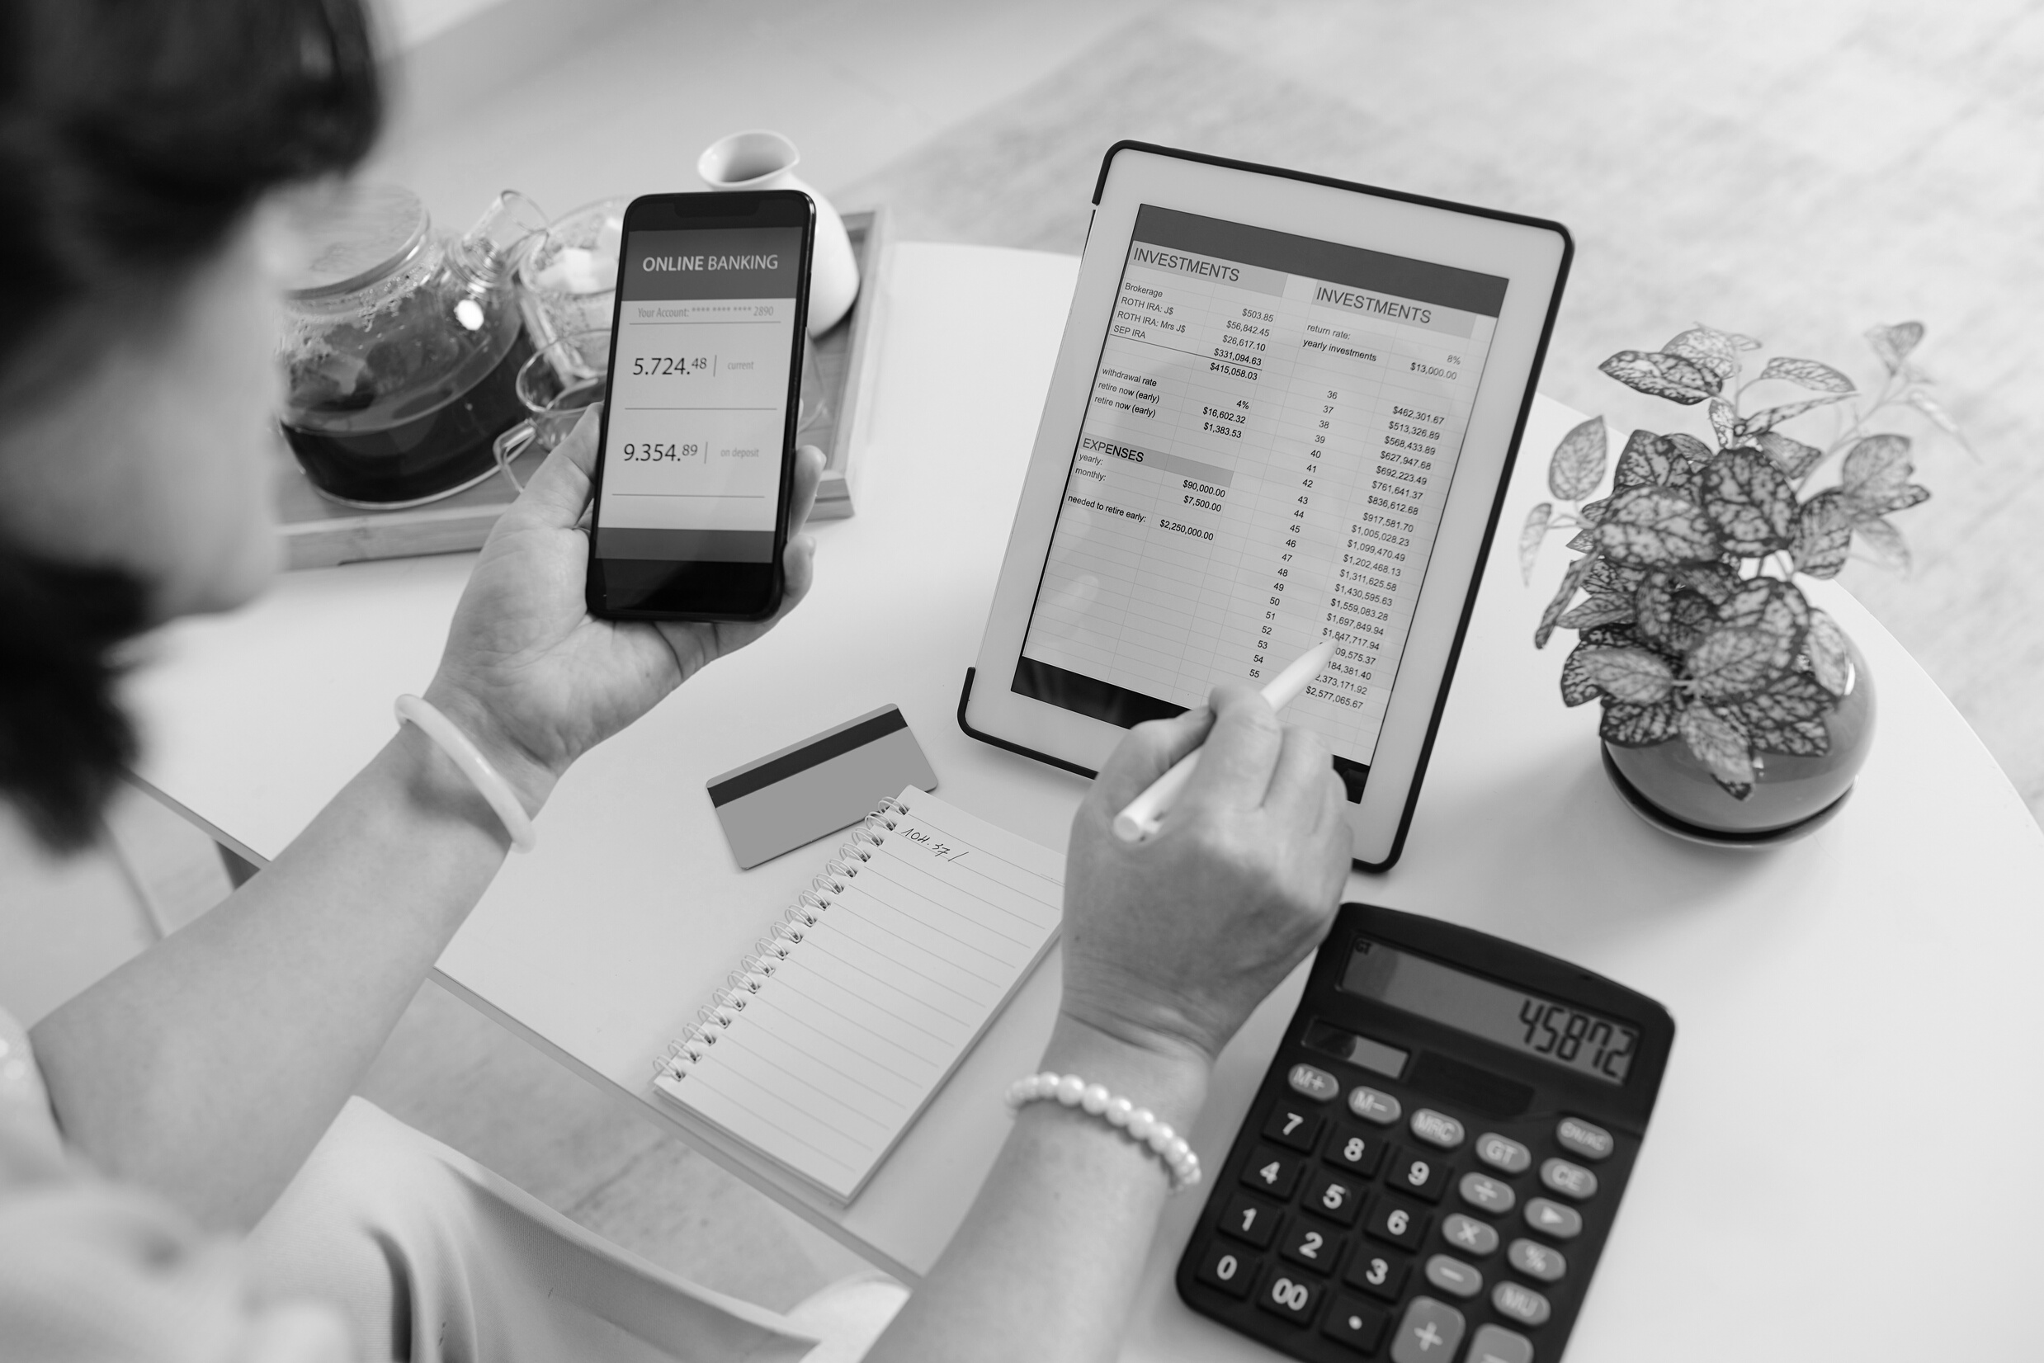

GETTING
STARTED
ASSETS
ACCOUNTS

Slide 5

Master your money today to enjoy more of it tomorrow.

Slide 6



ASSETS.

Slide 7

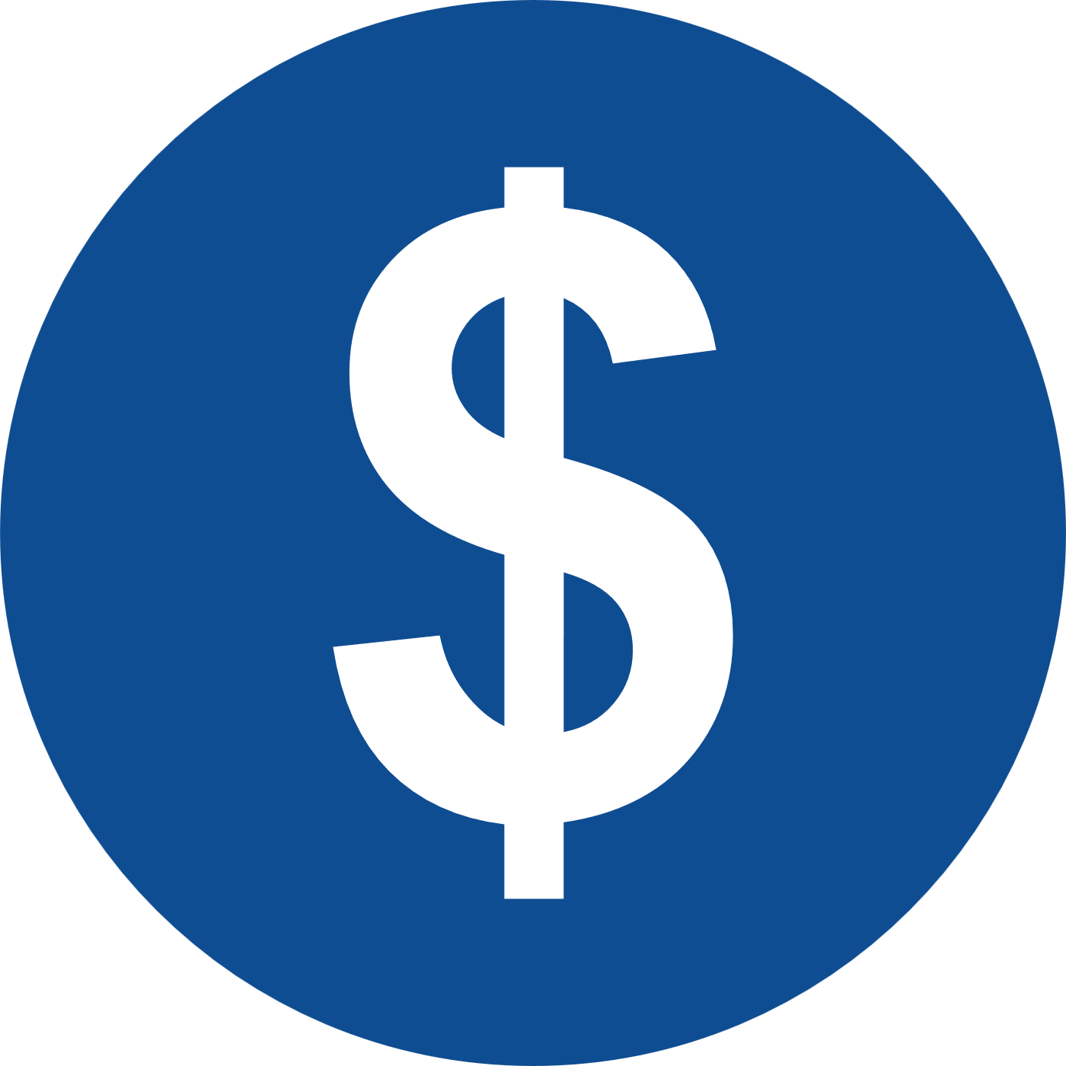
INVESTING
  Involves risk
  Higher growth potential
  Mid- or long-term goals
  May be illiquid
SAVING
  Rarely involves risk
  Lower growth potential
  Short-term goals
  Typically liquid

Slide 8
INVESTING
MITSAKES MISTAKES
Next

Slide 9


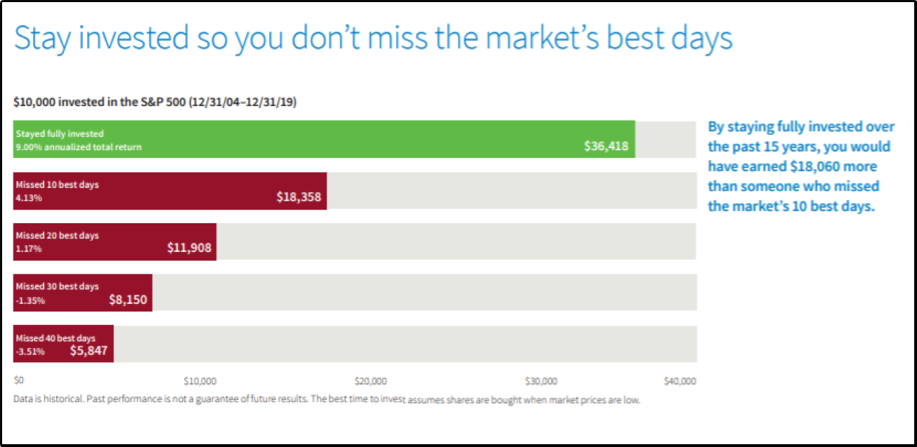
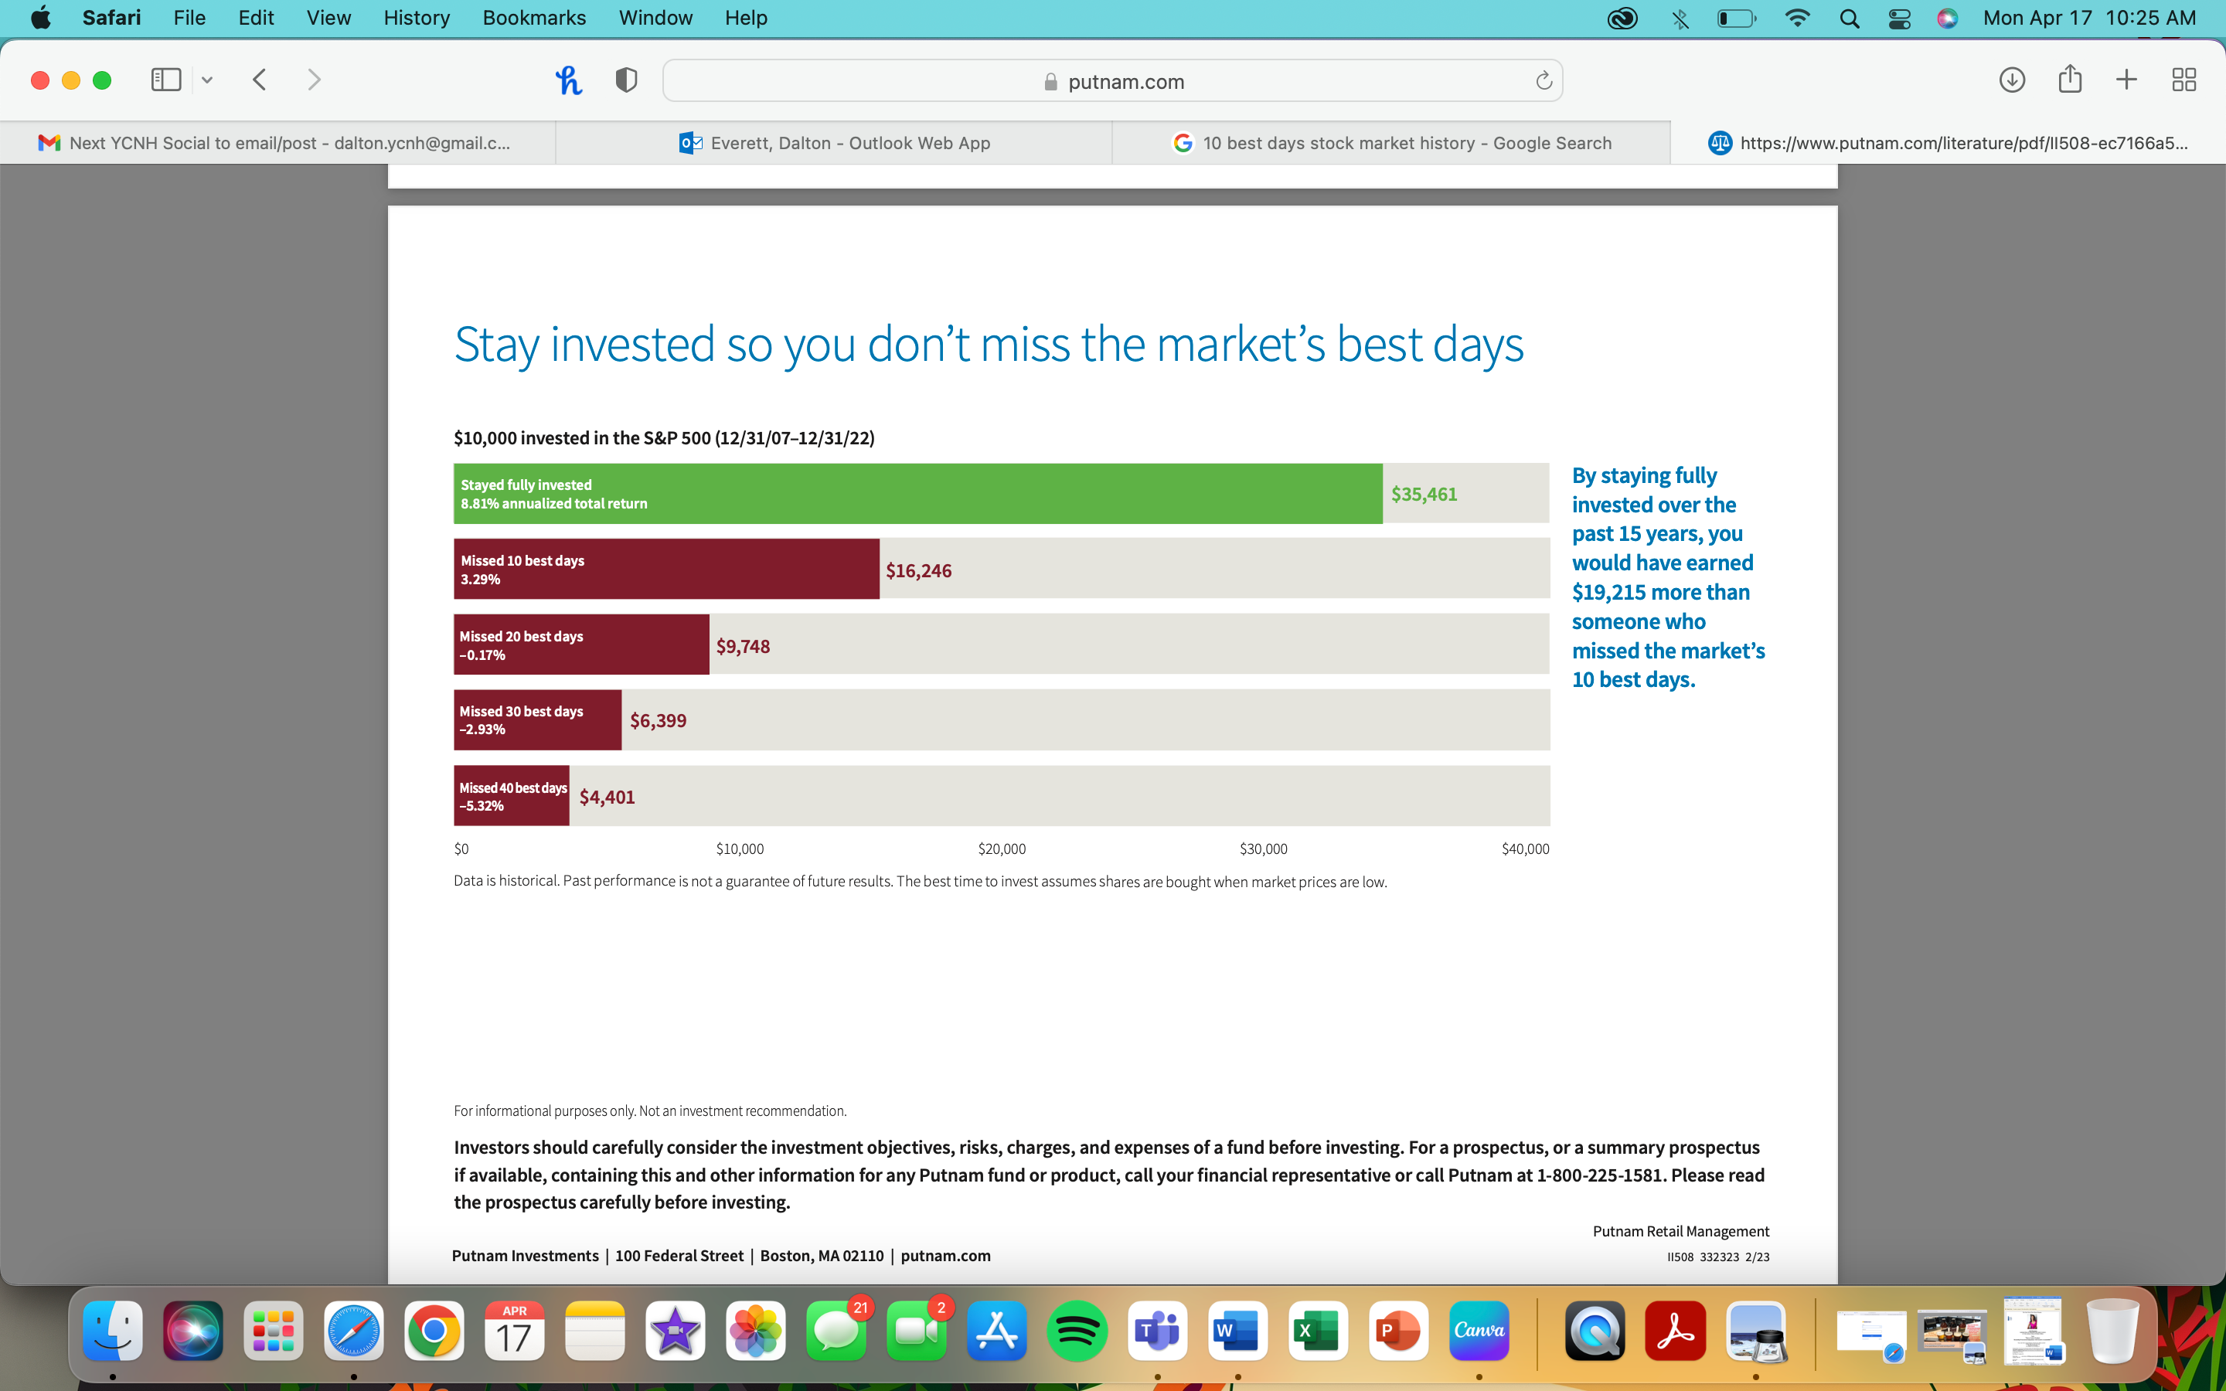
MARKET TIMING

Slide 10
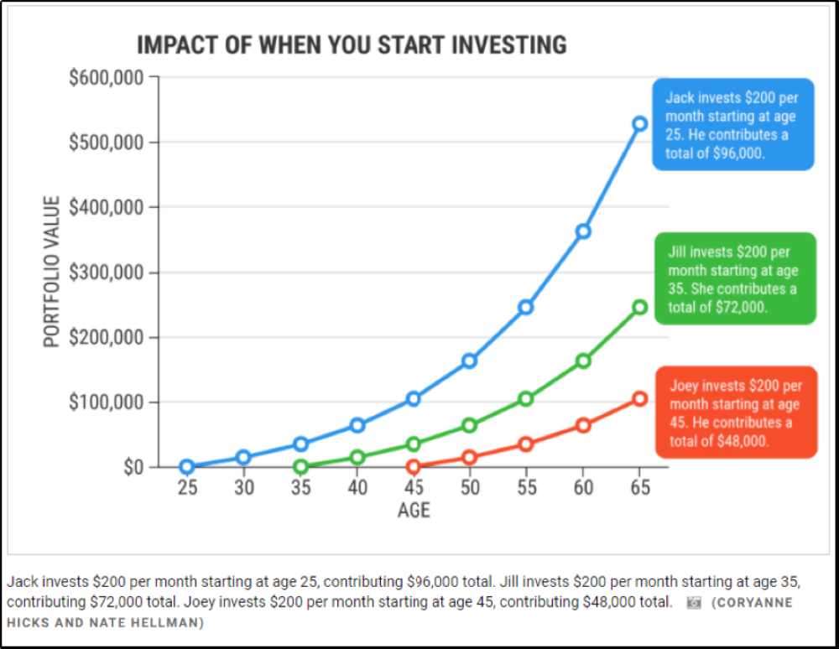
WAITING TO INVEST
(Assuming a 7% flat rate)
*hypothetical example*

Slide 11
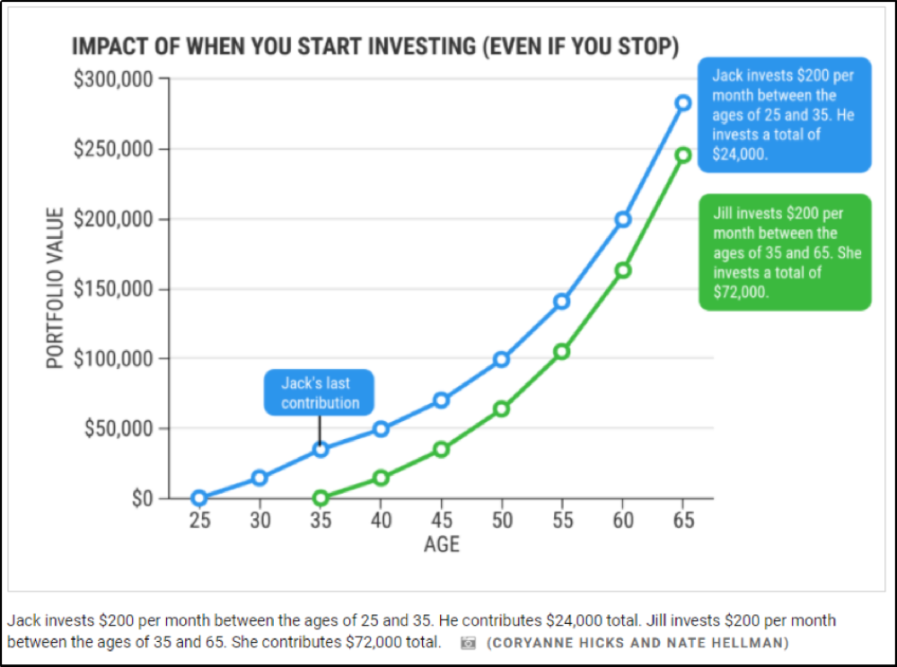
WAITING TO INVEST
(Assuming a 7% flat rate)
*hypothetical example*

Slide 12



ACCOUNTS.

Slide 13

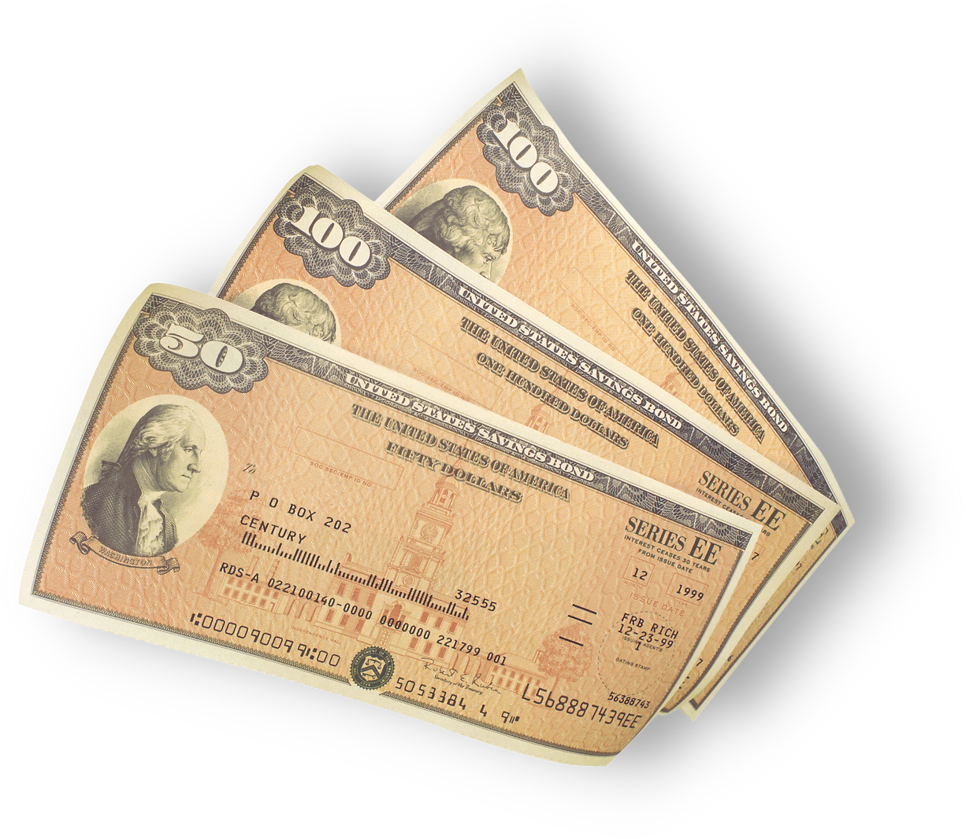

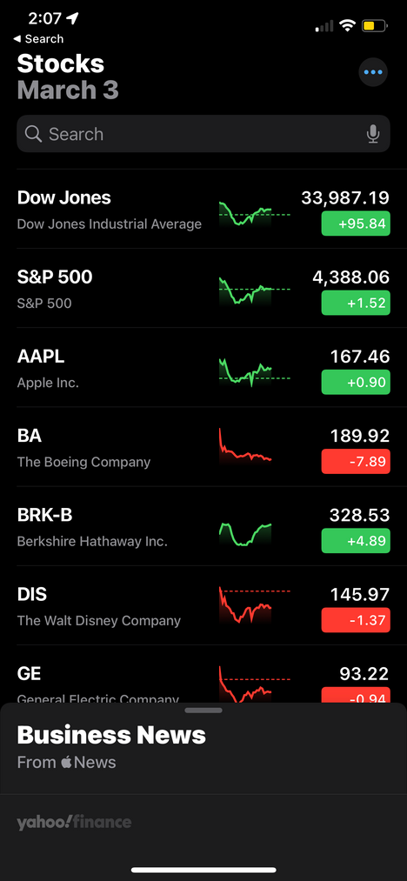
DIFFERENT TYPES
STOCKS
BONDS
CASH EQUIVALENTS

Slide 14
?
STOCKS
BONDS
CASH EQUIVALENTS
OTHER
FUNDS
MUTUAL FUNDS
INDEX FUNDS
Active Management
Passive Management
$$$
$
ETF
Mutual funds are sold by prospectus only and are subject to various types of risk. Before investing in a mutual fund, carefully review the fund’s prospectus and consider the fund's investment objectives, risks, charges and expenses.
ETF
Trade intra-day
Trade intra-day

Slide 15
TYPES OF ACCOUNTS:
What are my different options?
Retirement vs. Non-Retirement

Slide 16

RETIREMENT:
  Post-Age 59 1/2
  Tax Deferral
  Pre-Tax & Post-Tax
  Through Employer
NON-RETIREMENT:
  Use Any Time
  Taxable
  JTWROS
  Through Self or Brokerage

Slide 17


RISK VS. RETURN
High
STOCKS
BONDS
POTENTIAL
RETURN
CASH
Low
High
Risk

Slide 18

this
WHAT DOES MEAN?
This indicates that:
An investor (you) must consider their individual risk tolerance when constructing a portfolio
Things to consider include overall risk tolerance but also the potential to replace lost funds
The higher the risk
The higher the reward
*and vice versa

Slide 19
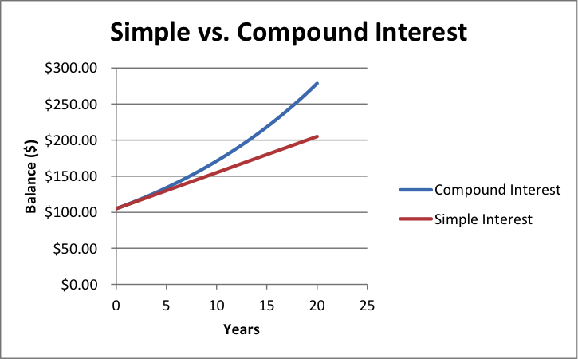
WHAT IS COMPOUND INTEREST?
Compound interest, also known as compounding interest, is the interest on a loan or deposit that is calculated based on both the initial principal and accumulated interest from the previous periods
Generating "interest on interest" is known as the power of compound interest.

Slide 20

RE
BALANC
ING
Next

Slide 21
this
WHAT DOES MEAN?
Often happens to ensure the amount of risk involved is aligned with the investors desired level
The process of realigning the weight of your assets in a portfolio
Rebalancing does not necessarily mean you have to do a 50/50 distribution

Slide 22
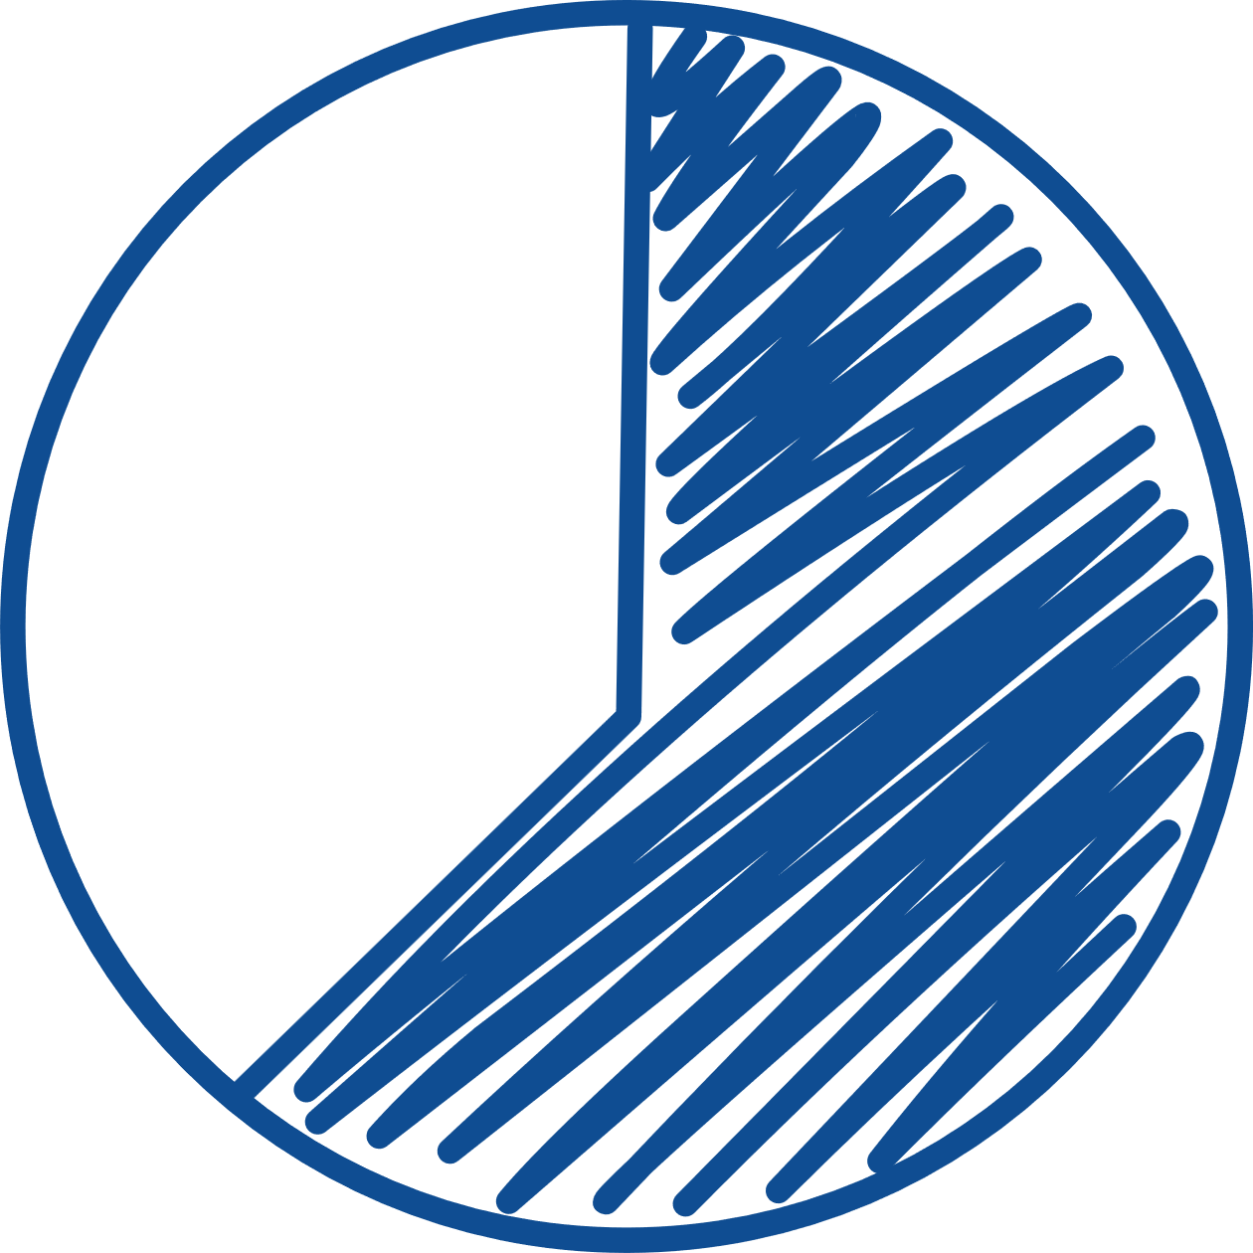
CREATING A
PORTFOLI
Next

Slide 23
Ask yourself:
BEFORE
YOU START
How much am I willing to lose?
How long do I have until I need the money?
Do I want my investing to reflect certain values?
Do I need immediate access to the money?
Do my expectations align with my investments?

Slide 24

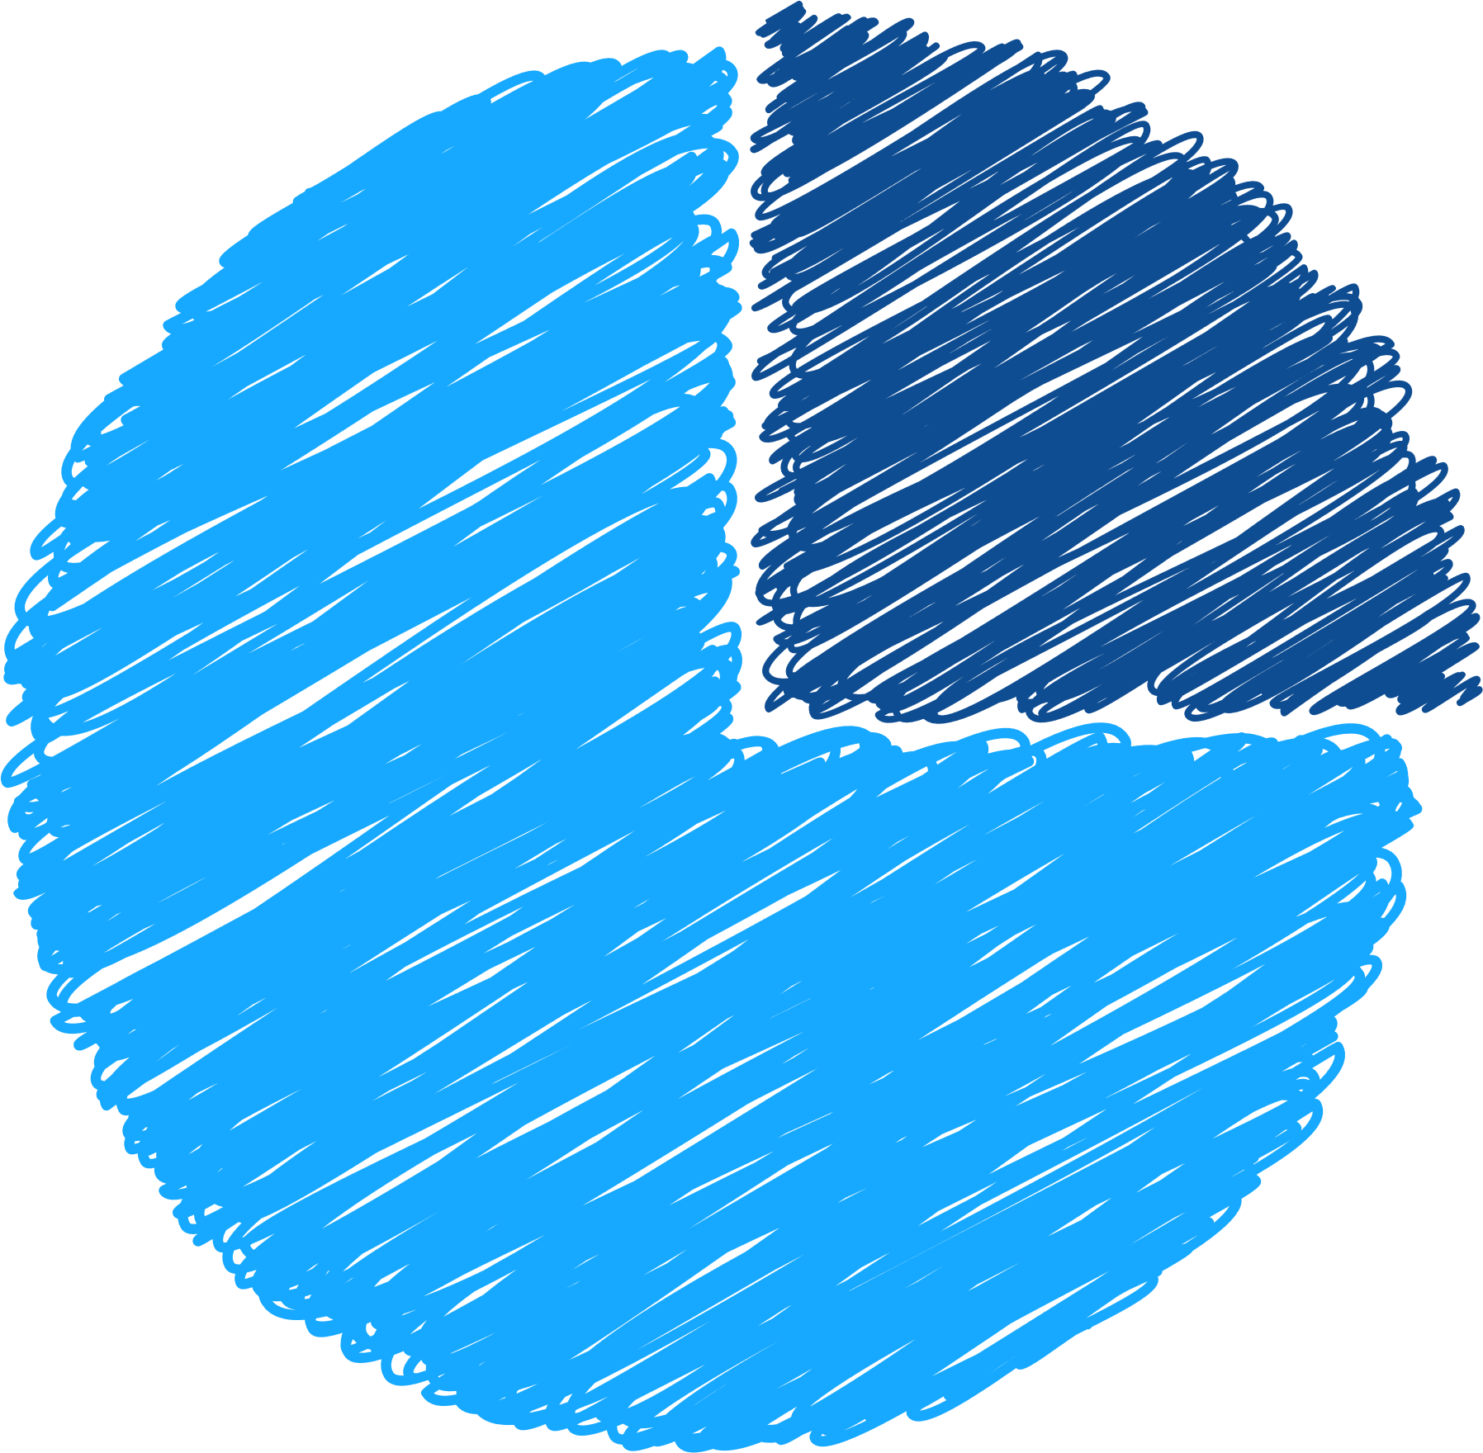

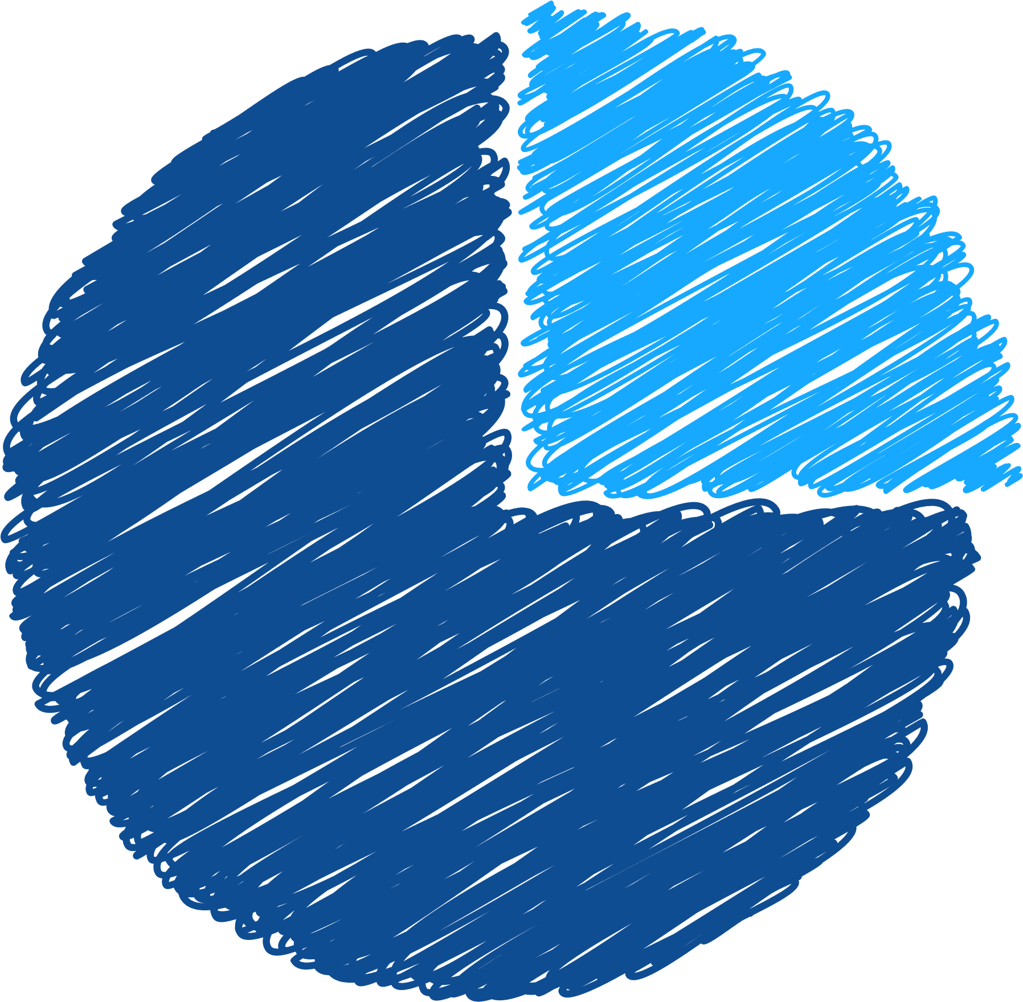
COMMON PORTFOLIO ALLOCATIONS
CONSERVATIVE
MODERATE
AGGRESSIVE
25%
25%
75%
50%
50%
75%
Stocks
Bonds
Stocks
Bonds
Stocks
Bonds
Not all strategies may be appropriate for all investors.

Slide 25




GETTING STARTED.

Slide 26

DIY
ROBO-ADVISORS
PROFESSIONAL
PORTFOLIO MANAGER
  Relatively low cost
  Relatively low cost
  Relatively higher cost
  Complete control over creating and managing your portfolio
  Some control over creating and managing a portfolio
  Professional management of portfolio

Slide 27
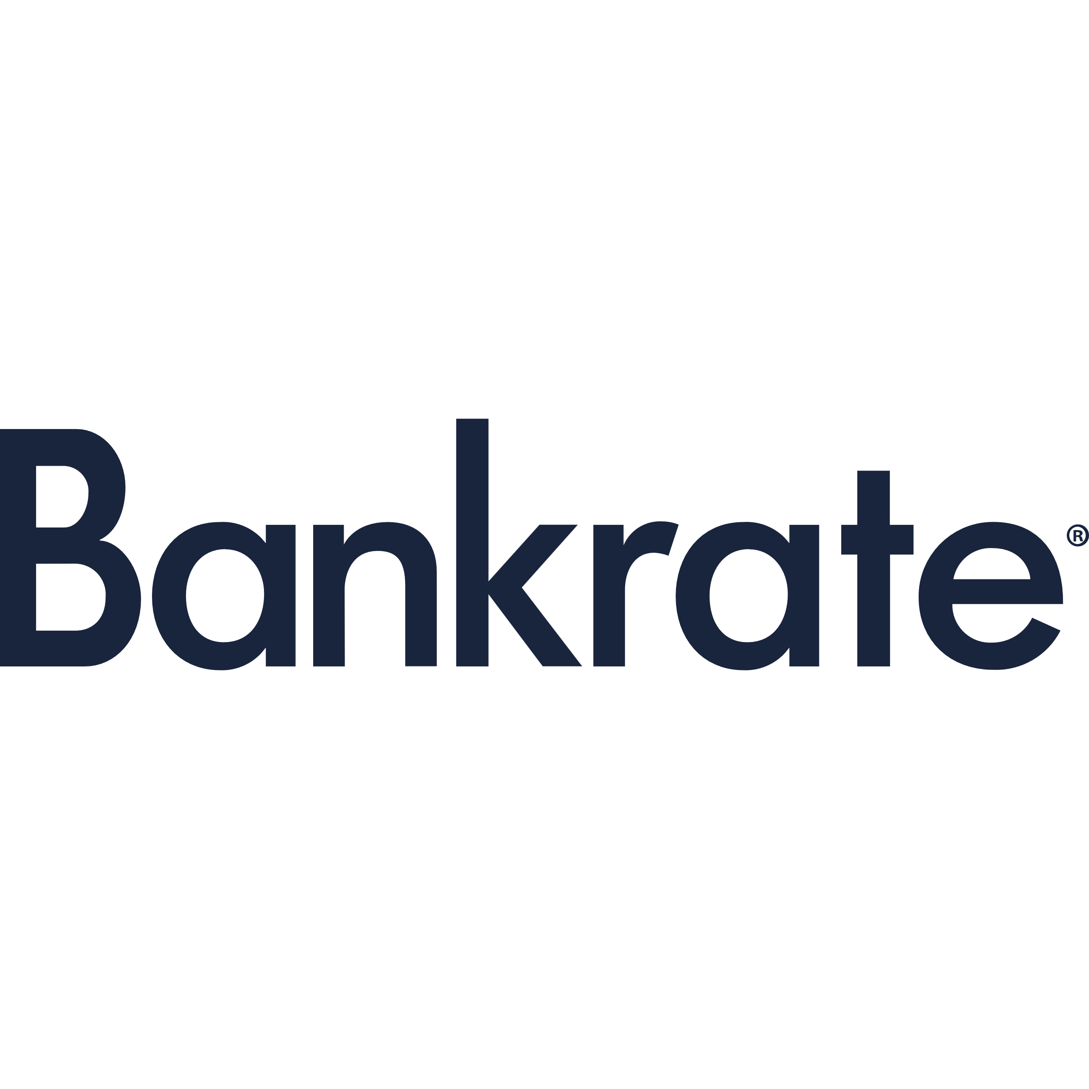

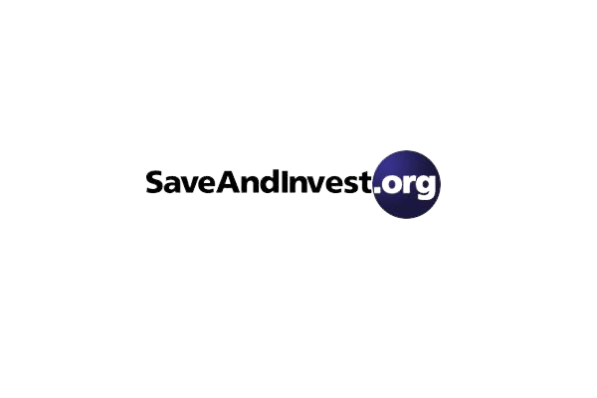

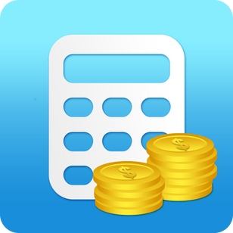

FNCALCULATORS.COM

Slide 28

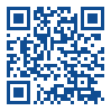
XIÈXIÈ
MERCI
JOHN CASERTA
GRACIAS
calendly.com/jcaserta
GRAZIE
DZIĘKUJĘ
NATHALIE EDEEN
calendly.com/nedeen-1
THANK YOU
AMY CROOKSHANK
Registered Representative of, Securities and investment advisory services offered through Hornor, Townsend & Kent, LLC. Registered Investment Adviser. Member FINRA/SIPC. 600 Dresher Road, Horsham PA 19044. 800-873-7637, www.htk.com. HTK is a wholly-owned subsidiary of The Penn Mutual Life Insurance Company. HTK does not offer tax or legal advice. Caserta & de Jongh, LLC is unaffiliated with Hornor, Townsend, and Kent. For Educational Purposes Only - Not to be relied upon as financial advice. Not all topics discussed may be suitable for all investors.
3920727RB_Nov23
CONTACT US
calendly.com/acrookshank
Scan here!

