Slide 1




MASTER YOUR MONEY
MASTER YOUR MONEY
What you need to know about money from budgeting to investing.

Slide 2

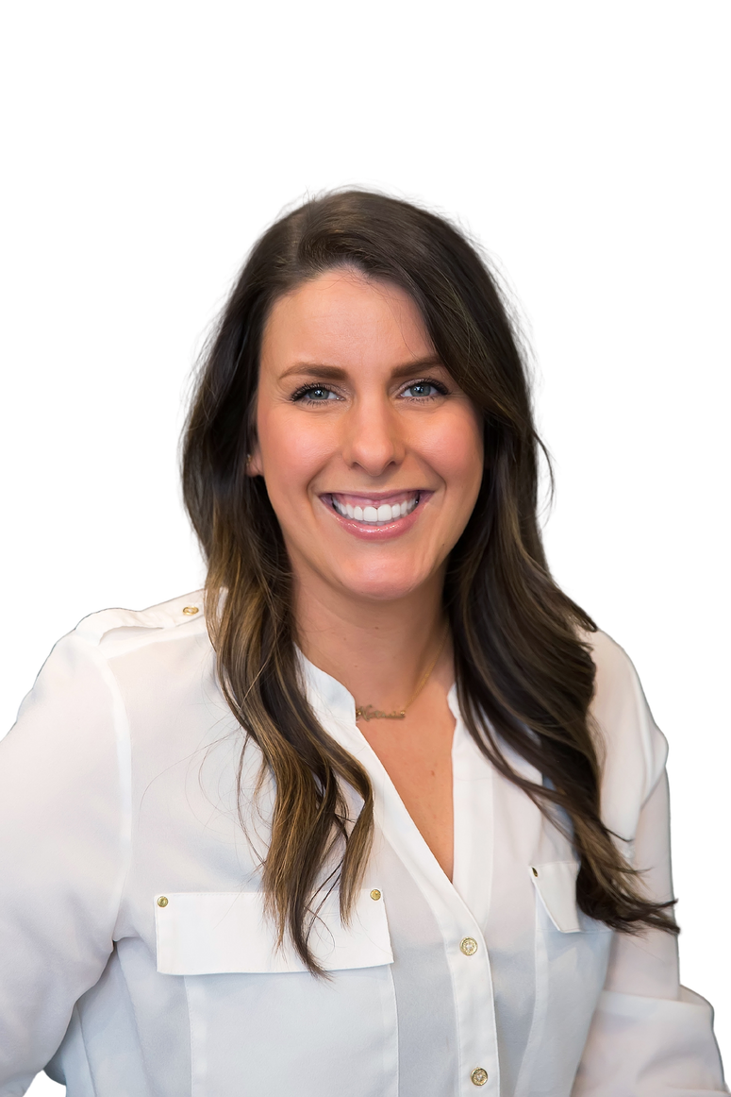
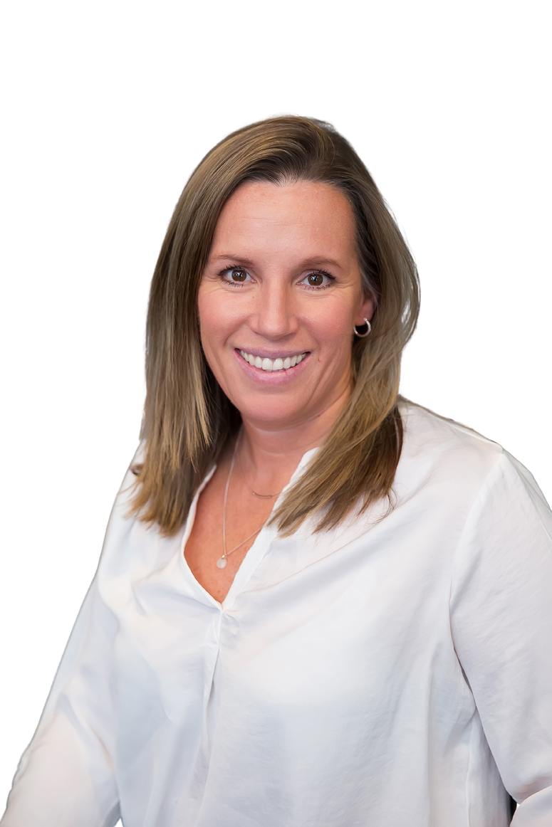

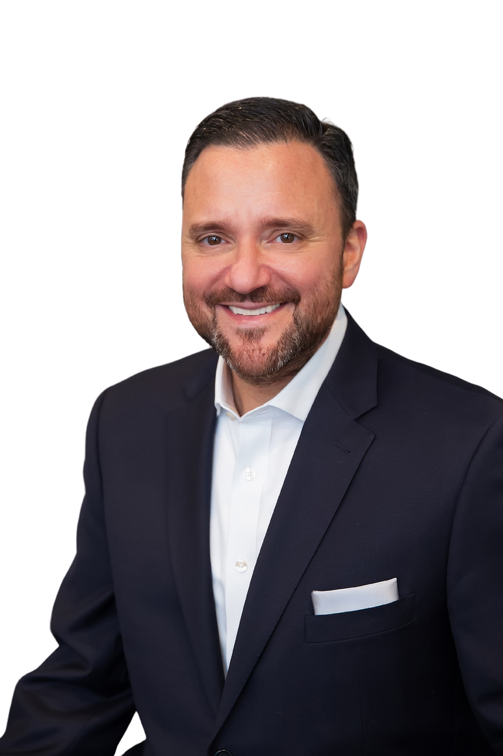


US
ABOUT
OUR SUPPORT
John Caserta, MSFS,
ChFC®, RICP®, CLU®
Managing Director
Nathalie Edeen
Advisor & Planning Specialist
Amy Crookshank
Advisor & Planning Specialist
Gimli
Office Support
Theo
Office Support

Slide 3








BUDGETING.
DEBT.
LOANS.
INVESTING.

Slide 4

BUDGETING.

Slide 5


What is a budget?
Managing the money coming in and the money going out​
Inflows – cash coming in​
Outflows – cash going out
What is a balanced budget?
Inflows - Outflows = $0

Slide 6







HOW TO TRACK
Pen & Paper
Spreadsheets
Free Apps
Paid Software

Slide 7

CREDIT
DEBIT
Acts as a loan
No interest if paid within billing period
Can help build credit history
Money comes directly from your bank account
Running as "credit" provides more protection
Does not help build credit
Money still comes from bank account

Slide 8

KEY
TAKEAWAYS
Pay yourself first
Build the habit of tracking income and expenses​
Find a method that works for you​
Periodically review your expenses (and trim them!)

Slide 9
DEBT.

Slide 10

Not all debt is created equally.
-John Caserta

Slide 11



TYPES OF DEBT
Typically lent by a bank to an individual or business
Often secured​
Low interest rates
Flexible repayment
Tax deduction
Used for appreciating assets
Often unsecured​
Typically used to purchase assets that depreciate in value​
High interest rates
Flexible repayment
No tax deduction
Used for depreciating assets
Good Debt
Bad Debt
Notes:
Secured Loans: Typically lent by a bank to an individual or business and backed by a physical asset, which is used as collateral for the loan​
Creditworthiness helps determine the ability to get the loan but and how much interest the borrower will pay​
Unsecured Loans: Typically lent by a bank to an individual or business without being backed by a physical asset​
The collateral is typically the paying ability of the individual or business​
Good Debt: Used to purchase assets that appreciate in value​
Typically lower interest rates than unsecured debt​
Tax deductions available
Bad Debt: Interest rates are typically higher than secured debt​; Interest is not deductible

Slide 12



Determine true cost of good debt​
Factor in deductions​
Compare potential investment returns with the cost of debt
Prioritize high interest debt​
Credit cards​
Personal loans

Slide 13


Subsidized
Unsubsidized
  These loans receive an interest subsidy in which the government pays accruing interest on your behalf while you’re enrolled in school and during periods of grace and authorized deferment. ​
  As of July 2012, direct subsidized loans (aka subsidized Stafford loans) are no longer available to graduate or professional students
  These loans accrue interest from the date of disbursement. If the interest is unpaid, it will be added back to the principal balance (original amount borrowed) at specific points via a process called capitalization. You are responsible for this interest.

Slide 14
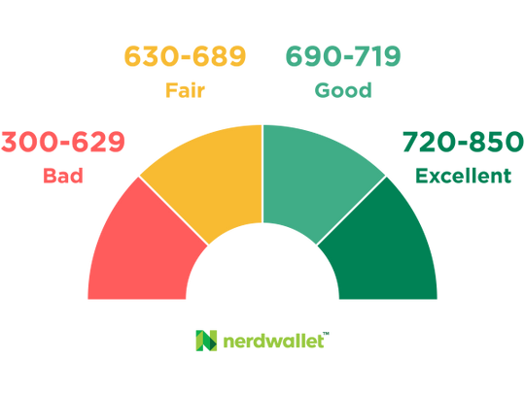
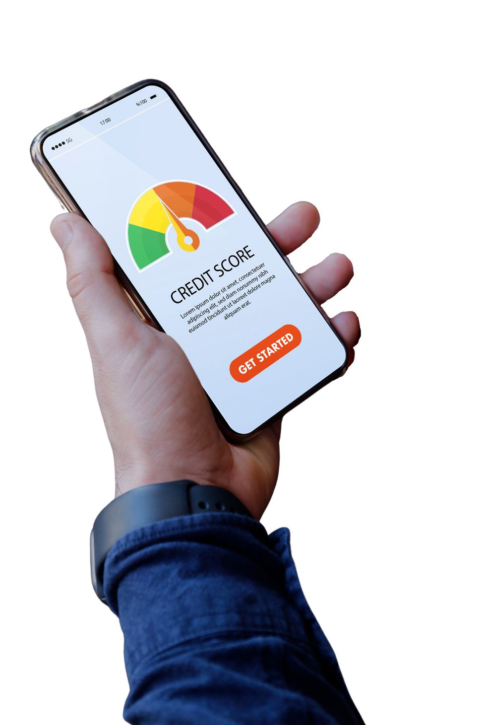
BUILDING
CREDIT HISTORY
What is a FICO Score?

Slide 15
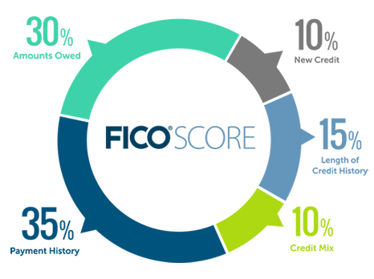
FICO Scores are calculated using many different pieces of credit data in your credit report. This data is grouped into 5 categories as you can see to the left.

Slide 16
KEY
TAKEAWAYS
Good vs. bad
Interest and capitalization
Length of repayment
Credit scores

Slide 17
LOANS.
+ Grants and Scolarsips

Slide 18


LOANS
  Borrowed from a lender​
  Pay back within a certain time frame with an interest rate​
  Can be from a private lender or the federal government
GRANTS
  Typically awarded to students based on financial need​
  Come from state or federal governments, non-profits, and schools​
  Generally, you do not have to pay them back
SCHOLARSHIPS
  Awarded specifically for education-related expenses​
  Can be awarded for a variety of reasons including merit, talent, or academic performance

Slide 19
INVESTING.

Slide 20



INVESTING
SAVING
  Involves risk
  Higher growth potential
  Mid- or long-term goals
  May be illiquid
  Rarely involves risk
  Lower growth potential
  Short-term goals
  Typically liquid

Slide 21
Ask yourself:
BEFORE
YOU START
How much am I willing to lose?
How long do I have until I need the money?
Do I want my investing to reflect certain values?
Do I need immediate access to the money?
Do my expectations align with my investments?

Slide 22



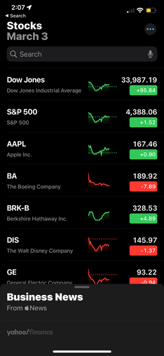
?
STOCKS
BONDS
CASH EQUIVALENTS
OTHER
FUNDS
MUTUAL FUNDS
INDEX FUNDS
Active Management
Passive Management
$$$
$
ETF
Mutual funds are sold by prospectus only and are subject to various types of risk. Before investing in a mutual fund, carefully review the fund’s prospectus and consider the fund's investment objectives, risks, charges and expenses.
ETF
Trade intra-day
Trade intra-day

Slide 23




COMMON PORTFOLIO ALLOCATIONS
CONSERVATIVE
MODERATE
AGGRESSIVE
25%
25%
75%
50%
50%
75%
Stocks
Bonds
Stocks
Bonds
Stocks
Bonds
Not all strategies may be appropriate for all investors

Slide 24

GETTING STARTED
DIY
ROBO-ADVISORS
PROFESSIONAL
PORTFOLIO MANAGER
  Relatively low cost
  Relatively low cost
  Relatively higher cost
  Complete control over creating and managing your portfolio
  Some control over creating and managing a portfolio
  Professional management of portfolio

Slide 25


XIÈXIÈ
MERCI
JOHN CASERTA
GRACIAS
calendly.com/jcaserta
GRAZIE
DZIĘKUJĘ
NATHALIE EDEEN
calendly.com/nedeen-1
THANK YOU
AMY CROOKSHANK
Registered Representative of, Securities and investment advisory services offered through Hornor, Townsend & Kent, LLC. Registered Investment Adviser. Member FINRA/SIPC. 600 Dresher Road, Horsham PA 19044. 800-873-7637, www.htk.com. HTK is a wholly-owned subsidiary of The Penn Mutual Life Insurance Company. HTK does not offer tax or legal advice. Caserta & de Jongh, LLC is unaffiliated with Hornor, Townsend, and Kent. For Educational Purposes Only - Not to be relied upon as financial advice. Not all topics discussed may be suitable for all investors.
5515060RG_Mar25
CONTACT US
calendly.com/acrookshank
Scan here!

