Slide 1




UNDERSTANDING
Debt
Managing your loans and debt.

Slide 2





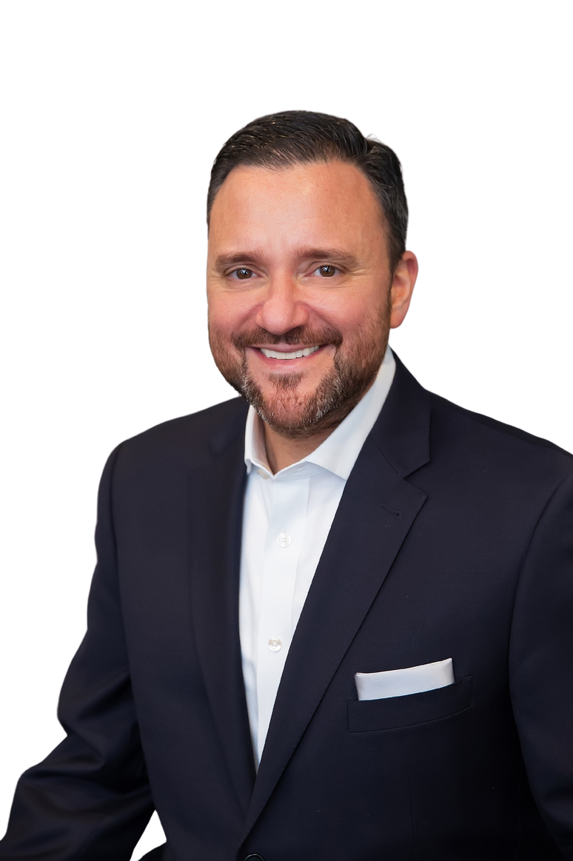


US
ABOUT
OUR SUPPORT
John Caserta, MSFS,
ChFC®, RICP®, CLU®
Managing Director
Nathalie Edeen
Advisor & Planning Specialist
Amy Crookshank
Advisor & Planning Specialist
Gimli
Office Support
Theo
Office Support

Slide 3



RESPONSIBLE
BORROWING
MANAGING YOUR LOANS
BUILDING
CREDIT

Slide 4


RESPONSIBLE
BORROWING
Tips on how
Plan ahead
Look at scholarships and grants
Make interest-only payments
Take advantage of tax benefits
Estimate the amount of debt you can afford
Contact your lender if you're struggling
Stay on Schedule
Prepay a student loan if possible
Notes:
As you make choices in how you finance your education, consider the following tips that can help you borrow responsibly:
Plan ahead: Budget your expenses at the start of every quarter and only borrow student loans that you’ll need to pay your school-related costs.
Look to scholarships and grants to cover the costs of higher education. Since scholarships and grants don’t have to be paid back, they’re free money to put toward the cost of your education.
Make interest-only payments on your student loans while you’re in school to save money in the long run when you’re repaying your loans.
Take advantage of tax benefits or incentives that are associated with your tuition and/or student loans.
Estimate the amount of debt you can afford. Use a repayment calculator to figure how much you’ll need to make your monthly loan repayments once you graduate.
If you are struggling to make loan payments, contact your lender. It is critical that you communicate your situation with your lender so that you can make appropriate arrangements that will protect your credit score.
Stay on schedule. Repaying a student loan on time can create and build an excellent credit history.
If you can prepay a student loan, do so. You won’t incur any penalties and you’ll save on the total interest due.

Slide 5

Ask yourself:
What kind of debts
will I have?

Slide 6




TYPES OF DEBT
Secured Loans
Unsecured Loans
Good Debt
Bad Debt
Examples​ include mortgage, car loans, and business loans
Examples​ include credit cards, personal loans, and student loans*
Typically lent by a bank to an individual or business
Often secured​
Often unsecured​
Typically used to purchase assets that depreciate in value​
Notes:
Secured Loans: Typically lent by a bank to an individual or business and backed by a physical asset, which is used as collateral for the loan.​
Creditworthiness helps determine the ability to get the loan but and how much interest the borrower will pay​.
Unsecured Loans: Typically lent by a bank to an individual or business without being backed by a physical asset​. The collateral is typically the paying ability of the individual or business​.
Good Debt: Used to purchase assets that appreciate in value​. Typically, lower interest rates than unsecured debt​. Tax deductions available.
Bad Debt: Interest rates are typically higher than secured debt​; Interest is not deductible.

Slide 7


MEDICAL SCHOOL
LOANS
Subsidized
Unsubsidized
Link Name
Link Name
Link Name
Link Name

Slide 8


Subsidized
Unsubsidized
These loans receive an interest subsidy in which the government or your medical school pays accruing interest on your behalf while you’re enrolled in school and during periods of grace and authorized deferment. ​
As of July 2012, direct subsidized loans (aka subsidized Stafford loans) are no longer available to graduate or professional students
These loans accrue interest from the date of disbursement. If the interest is unpaid, it will be added back to the principal balance (original amount borrowed) at specific points via a process called capitalization. You are responsible for this interest.

Slide 9

UNDERSTANDING THE
Total Cost
Consider the following:
Interest
Capitalization
Length of Repayment

Slide 10
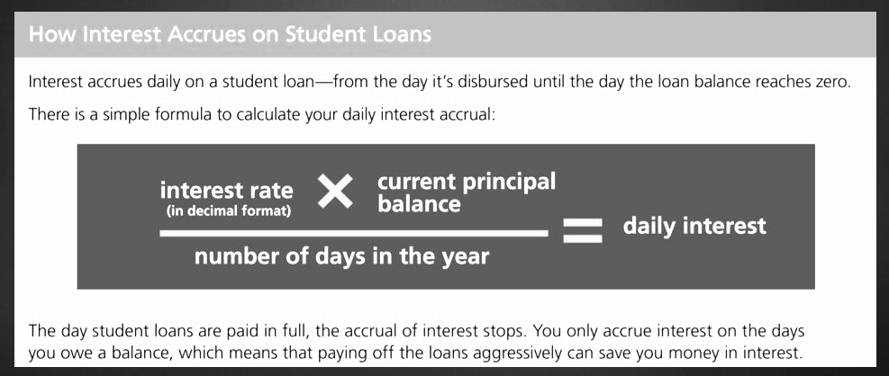
Depending on the loan and when it was disbursed, interest rates can
range from 5.3% to 7.9%

Slide 11
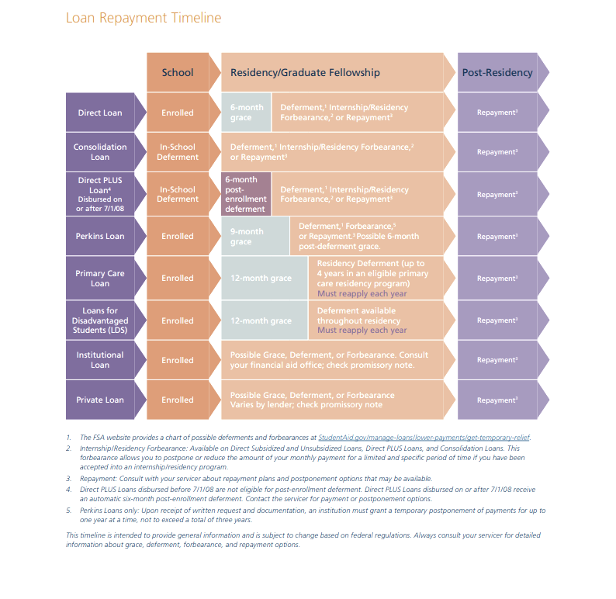

LOAN
REPAYMENT
TIMELINE

Slide 12
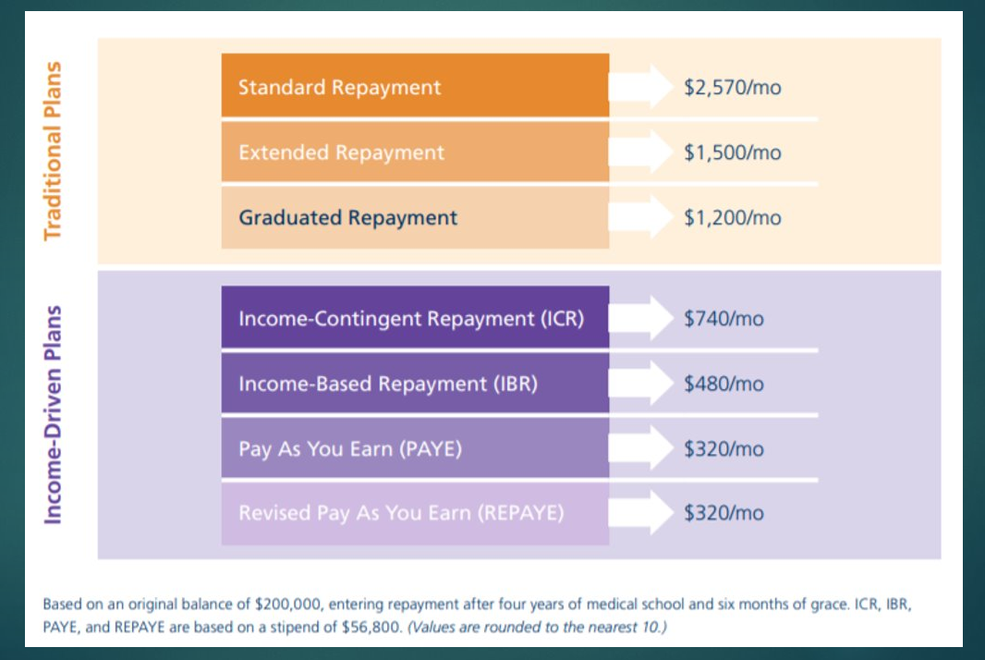

MANAGING
DEBT
REPAYMENT

Slide 13



Determine true cost of good debt​
Factor in deductions​
Compare potential investment returns with the cost of debt
Prioritize high interest debt​
Credit cards​
Personal loans

Slide 14
OTHER
CONSIDERATIONS
Public Service Loan Forgiveness​
No income limitations​
Need to be on an income-based repayment plan​
Based on your income, you could pay off your debt prior
to realizing any public loan forgiveness

Slide 15

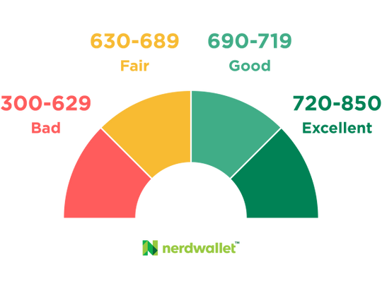

BUILDING
CREDIT HISTORY
What is a FICO Score?

Slide 16
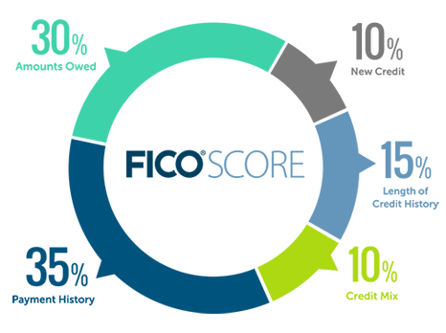
FICO Scores are calculated using many different pieces of credit data in your credit report. This data is grouped into 5 categories as you can see to the left.

Slide 17

XIÈXIÈ
MERCI
JOHN CASERTA
GRACIAS
calendly.com/jcaserta
GRAZIE
DZIĘKUJĘ
NATHALIE EDEEN
calendly.com/nedeen-1
THANK YOU
AMY CROOKSHANK
Registered Representative of, Securities and investment advisory services offered through Hornor, Townsend & Kent, LLC. Registered Investment Adviser. Member FINRA/SIPC. 600 Dresher Road, Horsham PA 19044. 800-873-7637, www.htk.com. HTK is a wholly-owned subsidiary of The Penn Mutual Life Insurance Company. HTK does not offer tax or legal advice. Caserta & de Jongh, LLC is unaffiliated with Hornor, Townsend, and Kent. For Educational Purposes Only - Not to be relied upon as financial advice. Not all topics discussed may be suitable for all investors.
4730265DP_May24
CONTACT US
calendly.com/acrookshank
Scan here!

